Slide 1
The Agile Inception Deck
Team Gravity

Slide 2
GALWAY 2020
<Your sponsors>
Notes:
Project name – pick a cool sounding name for your project
Sponsors – list your project sponsors here (the people with the money)
Putting your sponsors name boldly out there for all to see is a great way to get their engagement and attention (necessary for any successful project).

Slide 3

Why are we here?
To provide people with easy access to information and ideas about Galway 2020
To create multipage website
To increase awareness about environment
To entertain
<#1 reason for doing this project>
Notes:
Write down all the reasons why your company would want to spend money on this project in the first place.
Then pick and highlight the most important one.

Slide 4
The elevator pitch
For [Galway 2020 event goers]
who [want easy and quick access to information]
the [Galway 2020]
is a [multipage website]
that [list event, hotels, restaurants and educate kids and adults]
Unlike [existing websites]
our project [informs, helps, engage and educate].

Slide 5
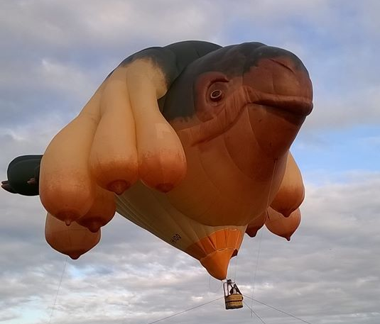
Product box
<Galway 2020 website>
<We will make your Galway 2020 adventure
fun and hassle free.”>
<exciting>
<innovative>
<easy to use>
Notes:
If you could walk into a store, and buy the shrink wrapped version of your software, what the design of the box look like and what would it say?
Point here is to get your team looking at your project through the eyes of your end customer.

Slide 6
The NOT list
IN | OUT
 | Accepting payments
UNRESOLVED
Notes:
List all the big ticket items you are (and are NOT) going to deliver within the scope of this project.
Before starting your project move all the UNRESOLVED ones to either IN or OUT.

Slide 7



Your project community
<non-profit organisations>
<local businesses>
Your core team
<artists and educators>
Everyone else !
... is always bigger than you think!
Notes:
List everyone you are going to have to interact with at some point during the course of your project.
Goal is to start building relationships with these people and let them know we are coming down the tracks (before we actually get there).

Slide 8



Technical solution
Technologies:
<HTML, CSS, JavaScript>
<libraries>
<tools>
<technology>
Danger!
Out of scope
Notes:
This is about letting people know how we plan on building this thing.
If there are any tools or libraries assumptions you are making list them here.
Also if there are areas of the application architecture that are risky highlight those too.

Slide 9

What keeps us up at night
<missing deadline>
<insufficient knowledge and expertise>
<………>
Notes:
This is your chance to call out any craziness you’ve heard while building the deck, and having a frank conversation with your sponsors and your team about how you are going to handle it.
This is perhaps on of the most powerful slides in the deck – it’s your chance to ask for whatever you need to be successful and the consequences if you don’t get it.
Use it!

Slide 10
The A-Team
# | Role | Competencies/Expectations
1 | Analyst | Comfortable with just-in-time analysis. Likes to test. Comfortable with rapid iterative development.
2 | Developers | C#, MVC.NET, jQuery, SQL Unit testing, refactoring, TDD, continuous integration
0.5 | Project manager | Responsible for outward facing communication Status reports, scope, budget, and reporting upwards
Notes:
Set expectations around who you are going to need and what kind of skills they will need to have to pull this off.
Use names if specific people are important (i.e. Billy is the only guy who can do X).

Slide 11

How big is this thing?
Ship it!
Construction
UAT
Training
~3months
1 wk
1 wk
This is a guess. Not a commitment.
Notes:
Give your sponsors some idea of how big this thing is (1, 3, or 6 monther).
Before you can complete this slide you and the team should create and estimate a high-level story list for the project.
This isn’t a commitment (too many unknowns). It’s just a really rough guess. Don’t treat it as anything else.

Slide 12
Trade-off sliders
 | The classic four
 | Feature completeness (scope)
 | Stay within budget (budget)
 | Deliver project on time (time)
 | High quality, low defects (quality)
OFF
ON
OFF
ON
OFF
ON
OFF
ON
 | Other important things
 | Ease of use
 | Don’t make me think!
 | Detailed audits (log everything)
 | <insert yours>
OFF
ON
OFF
ON
OFF
ON
OFF
ON
Notes:
When push comes to shove, something has to give. Here we want to be clear on what that is.
On agile projects we flex on scope. But there could be others factors at play here so get ready to listen as you customer tells you which forces can bend (scope) and which are written in stone (usually budget).
Slider rules:
1. No two sliders can occupy the same level.
2. List other important project factors down below.

Slide 13

The first release
Ship it!
Construction
UAT
Training
~3months
1 wk
1 wk
5 people, 3 month, $250K
Notes:
Stakeholders are usually interested in two things:
How much is this going to cost.
When is it going to be done.
Here we do our best to answer those two questions so they can decide if the project is still worth doing by showing them what it’s going to take.

